Slide 1
The Bender Rule, Low Resource Languages and Growth Languages
Kenneth Church
Nov 18, 2024

Slide 2
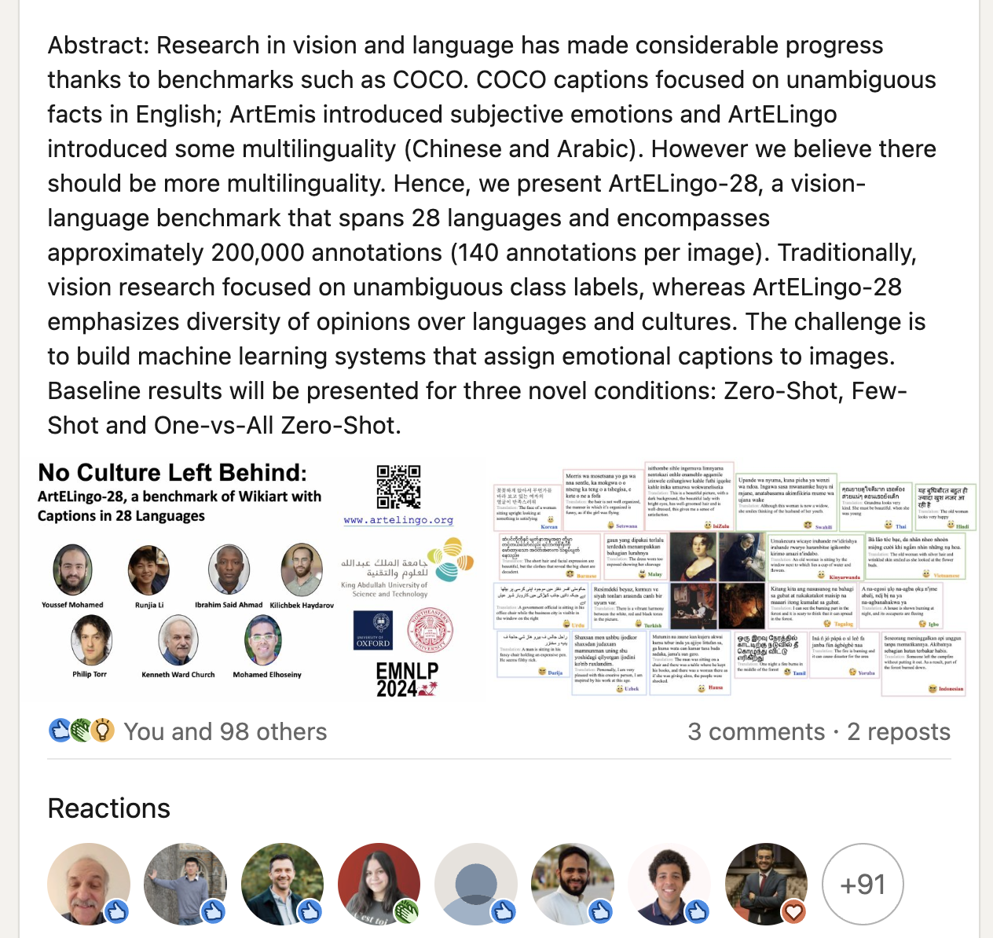


Lots of Interest from Lots of Places (110 Reactions) Benchmark + Baseline Results (not just data)
Baseline results will be presented for three novel conditions: Zero-Shot, Few-Shot and One-vs-All Zero-Shot
Hot Topic

Slide 3


Slide 5
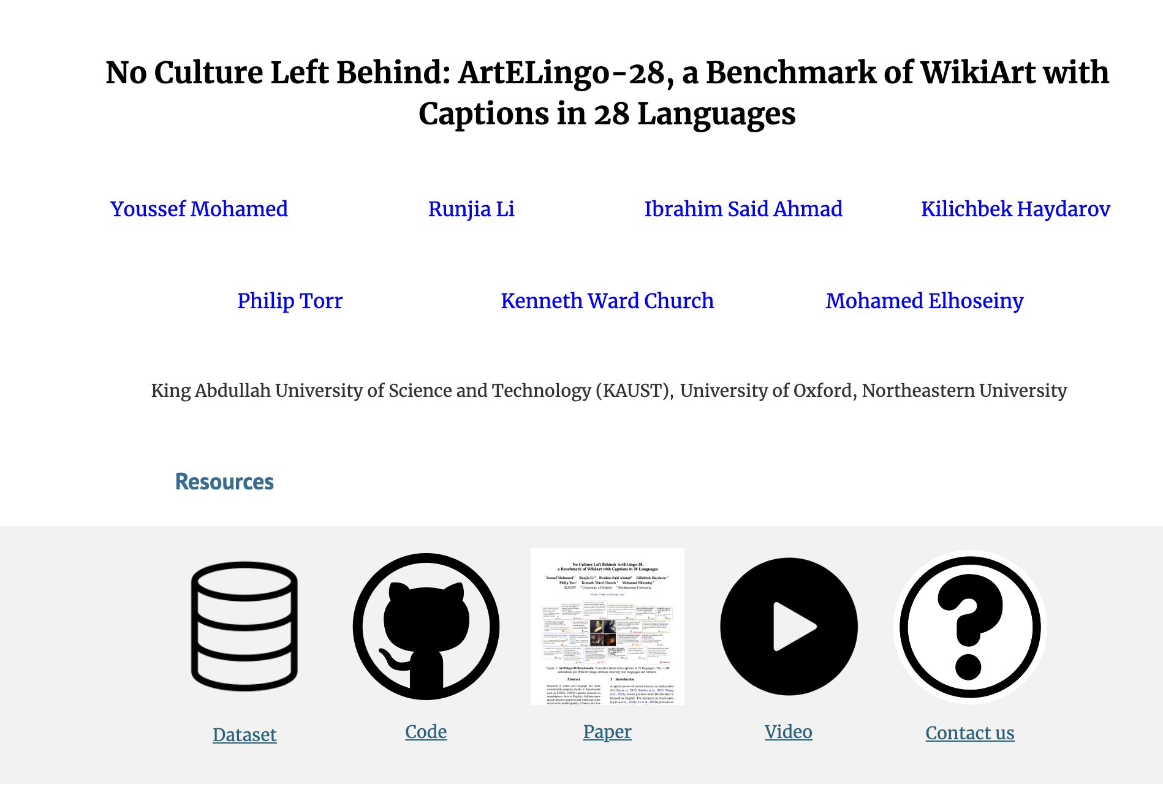

Website: Benchmark, Code, Paper & Video

Slide 6


Criticism: ACL is too focused on English https://thegradient.pub/the-benderrule-on-naming-the-languages-we-study-and-why-it-matters/

Slide 7
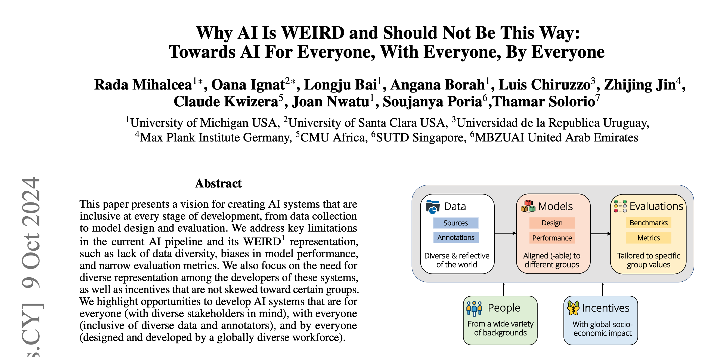

Weird = Western, Educated, Industrialized, Rich, and Democratic

Slide 8
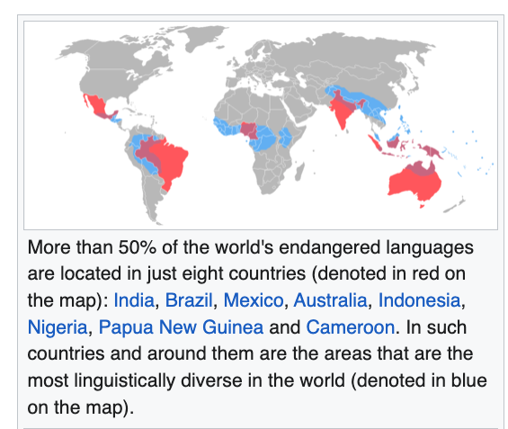
Low Resources & Growth Opportunities
Endangered Languages
50 Million Speakers or more
English, Chinese, Hindi, Spanish, Arabic, French, Bengali, Portuguese, Russian, Urdu, Indonesian, German, Japanese, Nigerian Pidgin, Marathi, Telugu, Turkish, Hausa, Tamil, Swahili, Tagalog, Punjabi, Korean, Persian, Javanese, Italian, Gujarati, Thai, Amharic, Kannada, Bhojpuri
https://en.wikipedia.org/wiki/Endangered_language
https://en.wikipedia.org/wiki/List_of_languages_by_total_number_of_speakers

Slide 9
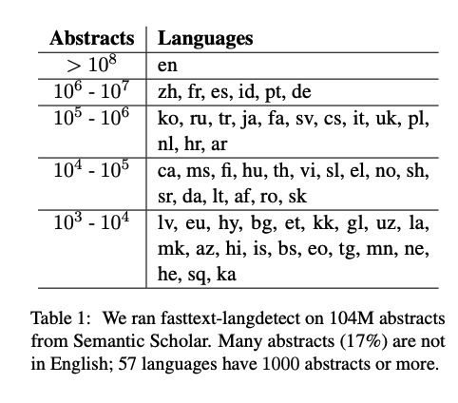
Good News
We have more resources
for growth languages in 2020s
than for English in 1990s
No Language Left Behind
Multilingual LLMs
Google Translate
Wikipedia (Common Crawl)
Opus Parallel Text
Abstracts in Semantic Scholar
Universal Dependencies
WordNet
Sketch Engine

Slide 10



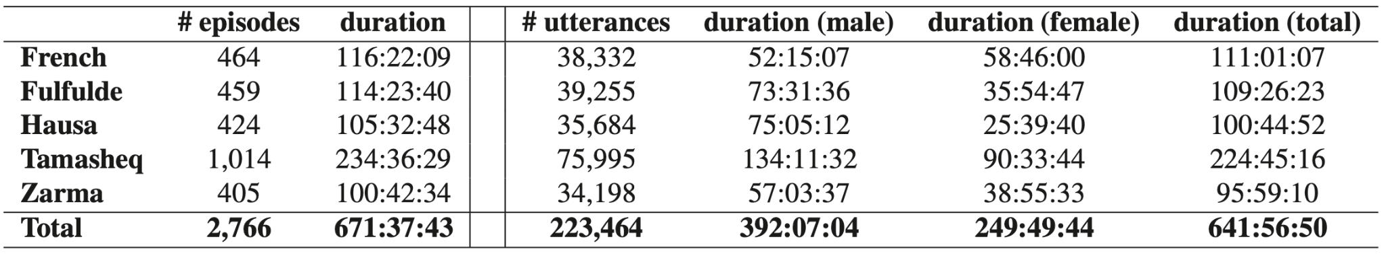

Slide 11
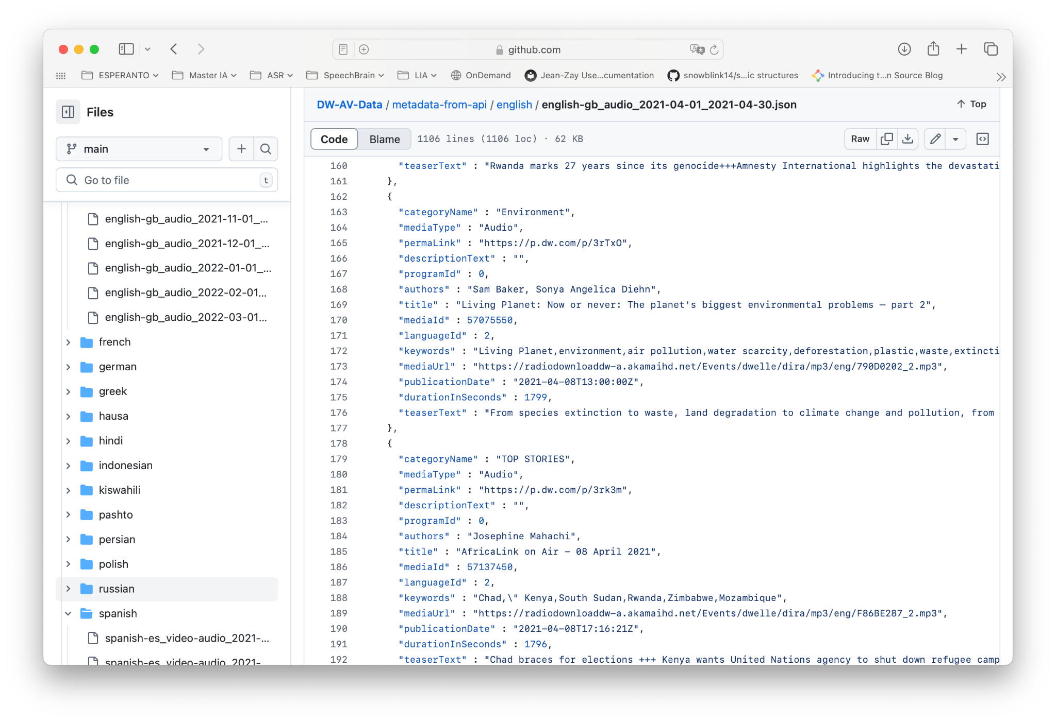
Data: Deutsche Welle TV (19 langages)

Slide 12
Restrictions Vectors → URLs → Copyrighted Material
Copyrighted material cannot be distributed
Data from the H2020 SELMA project is for research-purposes only
What can be distributed?
Models
Vector Database
URLs
Monitoring Service
Input spoken queries in 19 languages
Output vectors and URLs
Monolingual >> Bilingual

Slide 13
Concerns
Responsible AI (deadly and insanely profitable)
Data quality
Too much machine translation
Too few quality controls (by people with local expertise)
Lack of Expertise in Languages and Cultures
Too much Emphasis on Translation
Is it appropriate to use English as a pivot language
Is there a single model to rule them all?
Covering multiple perspectives

Slide 14
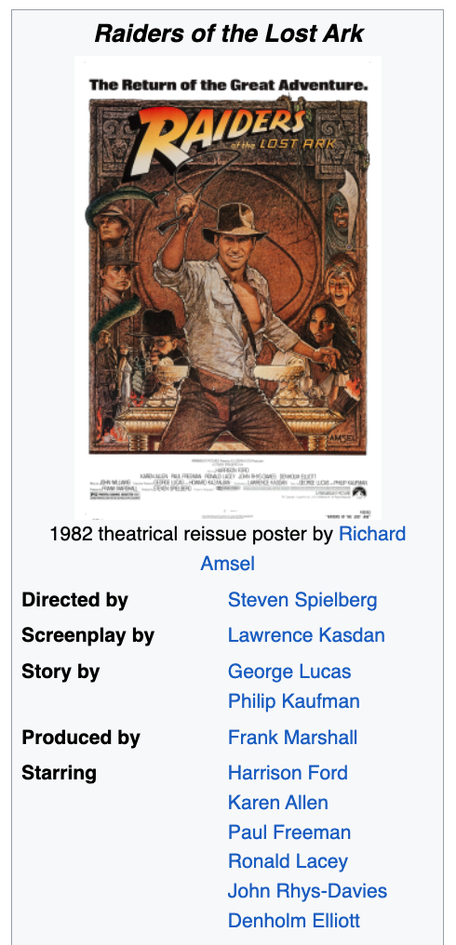



Move Fast and Break Things (Colonialism)
Irresponsible AI

Slide 15
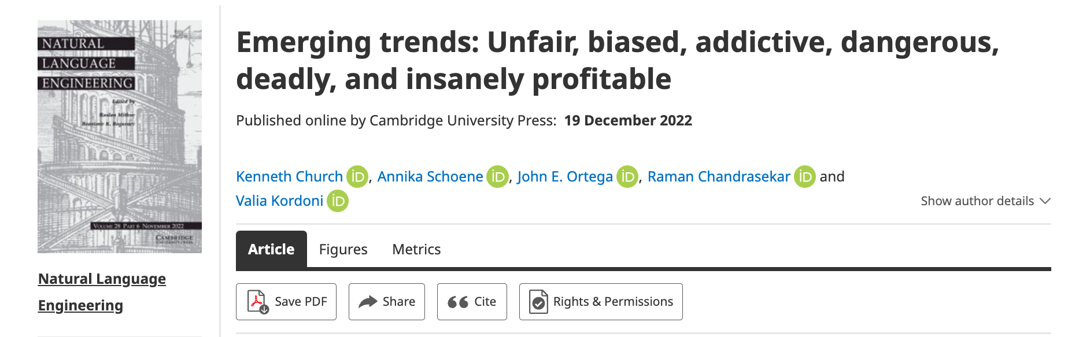



Responsible AI
Risks 1.0 (2016)
Unfair, Biased
Risks 2.0 (2022)
Addictive, Dangerous, Deadly and Insanely Profitable
American social media companies are not great at moderating online forums,
but they are worse in languages and cultures
that they do not understand all that well.

Slide 16


Deadly Consequences

Slide 17
Concerns
Responsible AI (deadly and insanely profitable)
Data quality
Too much machine translation
Too few quality controls (by people with local expertise)
Lack of Expertise in Languages and Cultures
Too much Emphasis on Translation
Is it appropriate to use English as a pivot language
Is there a single model to rule them all?
Covering multiple perspectives

Slide 18
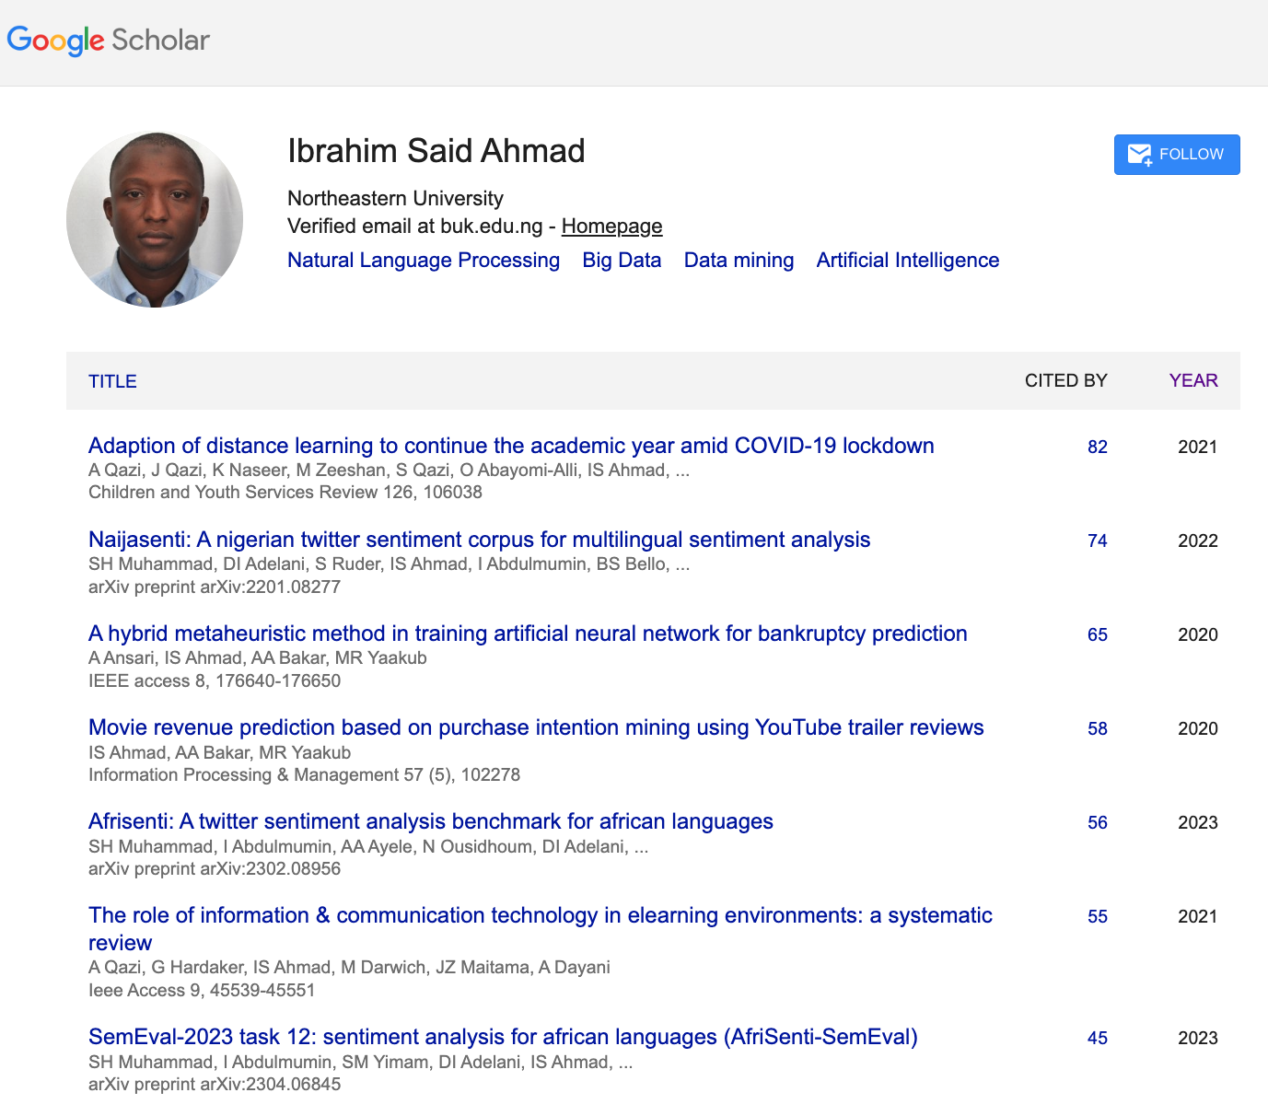
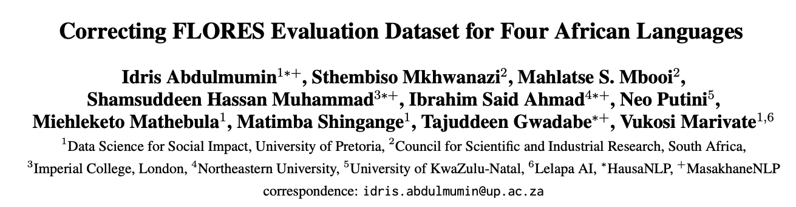
Engage Local Expertise
Hate speech is more toxic
in Hausa tweets than
in English tweets (in Nigeria)
Quality control is relatively weak in 4 African Languages
A significant part of the translations were suspected to have been automatically generated

Slide 19
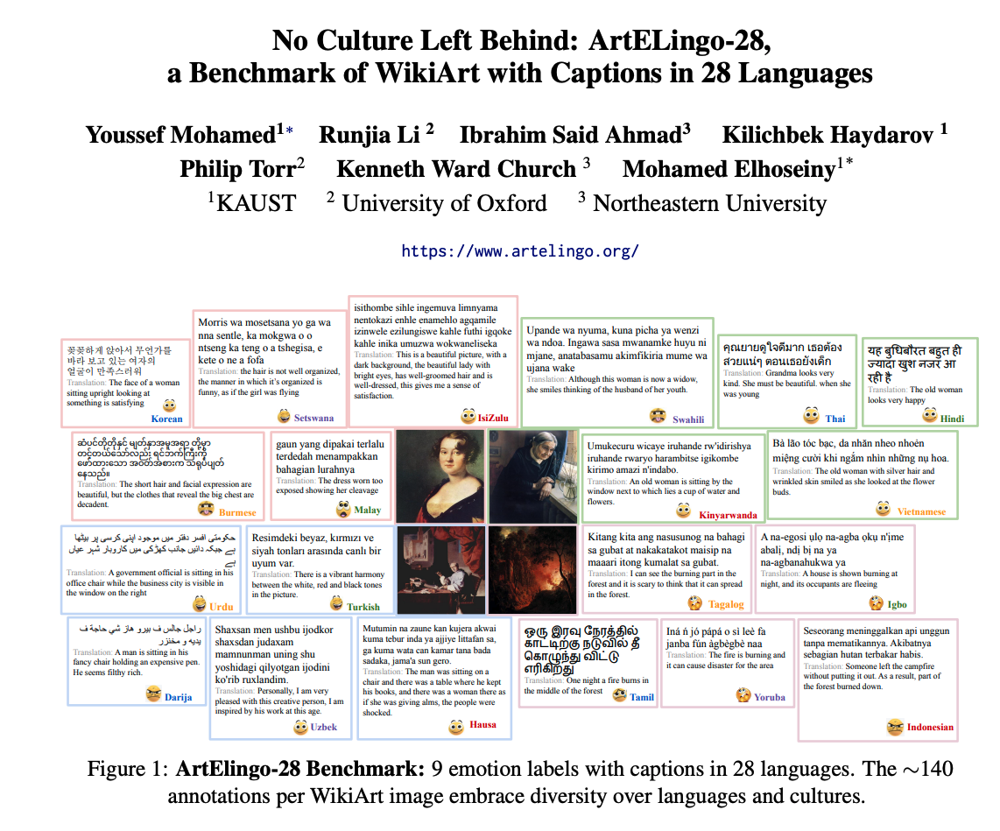
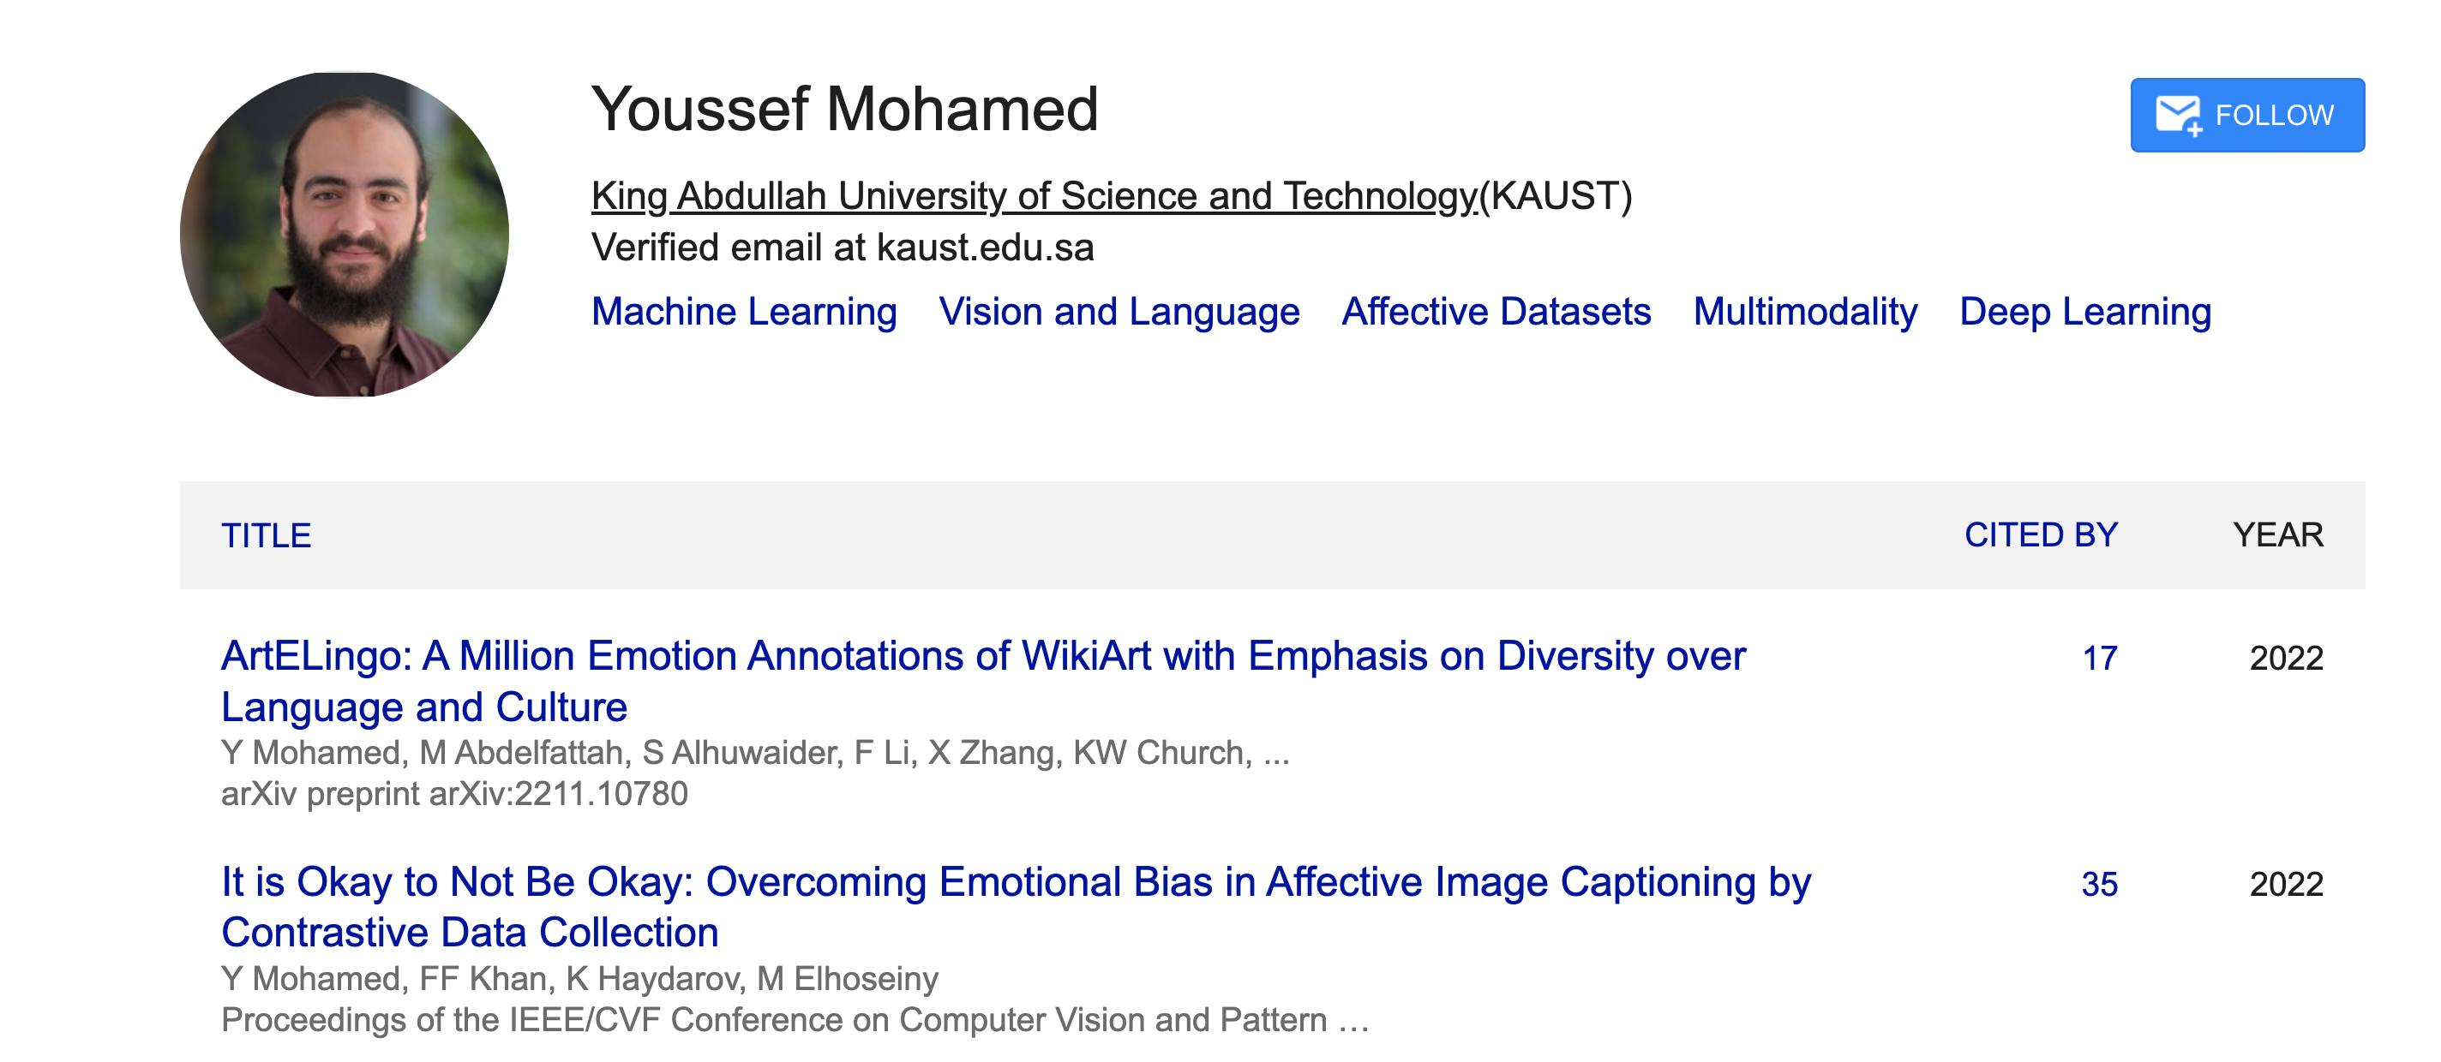
JSALT-2025 Teamwork Opportunity: Zoom → Face-to-Face

Slide 20
Concerns
Responsible AI (deadly and insanely profitable)
Data quality
Too much machine translation
Too few quality controls (by people with local expertise)
Lack of Expertise in Languages and Cultures
Too much Emphasis on Translation
Is it appropriate to use English as a pivot language?
Is there a single model to rule them all?
Covering multiple perspectives

Slide 21
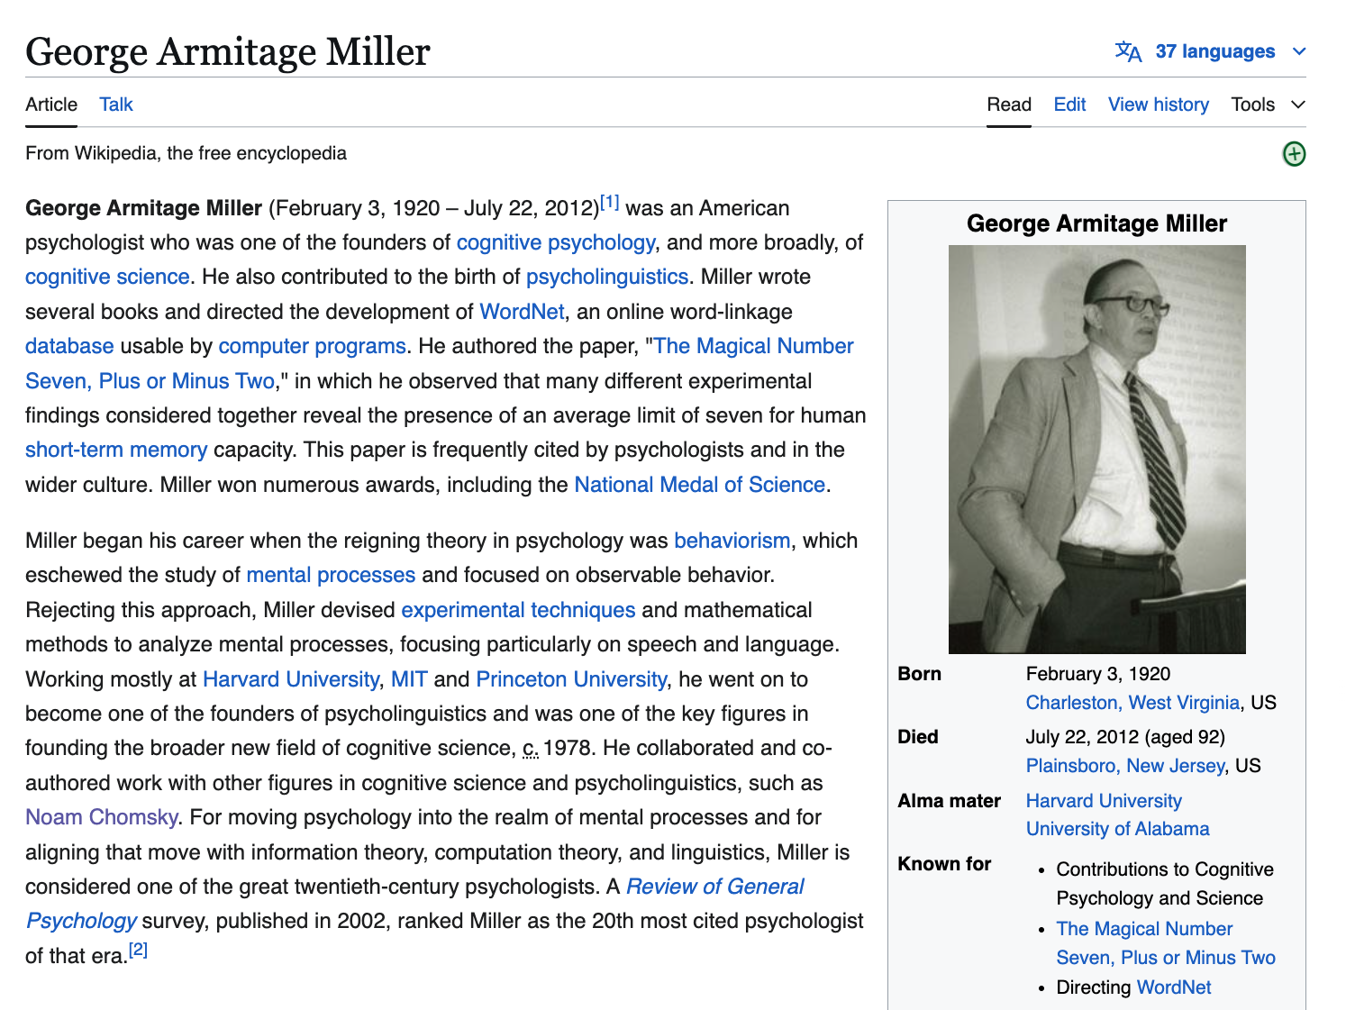
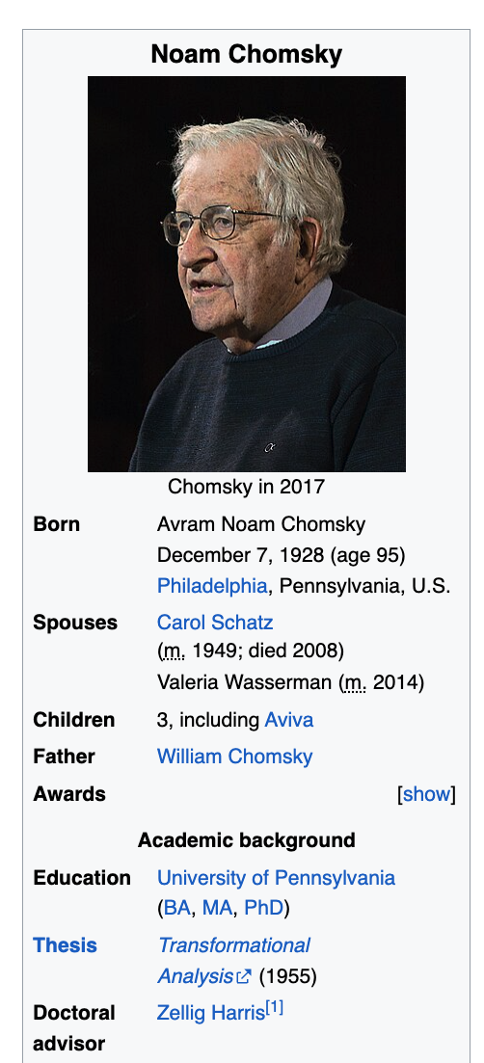

Slide 22
Avoid Translation (Pivoting via English)
WordNet
NRC-VAD (Google Translate)
wn.synset('dog.n.01').lemma_names('fra')
['canis_familiaris', 'chien']
wn.synset('cat.n.01').lemma_names('fra')
['chat']
wn.synset('house.n.01').lemma_names('fra')
['maison']
wn.synset('bank.n.01').lemma_names('fra')
['banque', 'rive’]
Supports 32 languages
But not Quecha, Galician, Hausa, Tamil
English | Hausa | Valence | Arousal | Dominance
aaaaaaah | aaaaaaa | 0.48 | 0.61 | 0.29
aaaah | aaaah | 0.52 | 0.64 | 0.28
aardvark | ardvark | 0.43 | 0.49 | 0.44
aback | abin mamaki | 0.39 | 0.41 | 0.29
abacus | abacus | 0.51 | 0.28 | 0.49
abalone | abalone | 0.50 | 0.48 | 0.41

Slide 23
Concerns
Responsible AI (deadly and insanely profitable)
Data quality
Too much machine translation
Too few quality controls (by people with local expertise)
Lack of Expertise in Languages and Cultures
Too much Emphasis on Translation
Is it appropriate to use English as a pivot language
Is there a single model to rule them all?
Covering multiple perspectives

Slide 24

Lack of Perspective in Chatbots
Homework for students in my NLP class
Write essays on Opium Wars
from six perspectives
including East and West
Feel free to use online tools:
chatbots, search, etc.
(but you are responsible for the content)
Chatbots view everything
from a single (American) perspective
Concern: even international students
handed in essays from Western perspective,
though they were taught another perspective in China
When bots over-simplify the truth,
and take our side of a conflict,
that could be dangerous
and could lead to a trade war,
if not a shooting war.

Slide 25
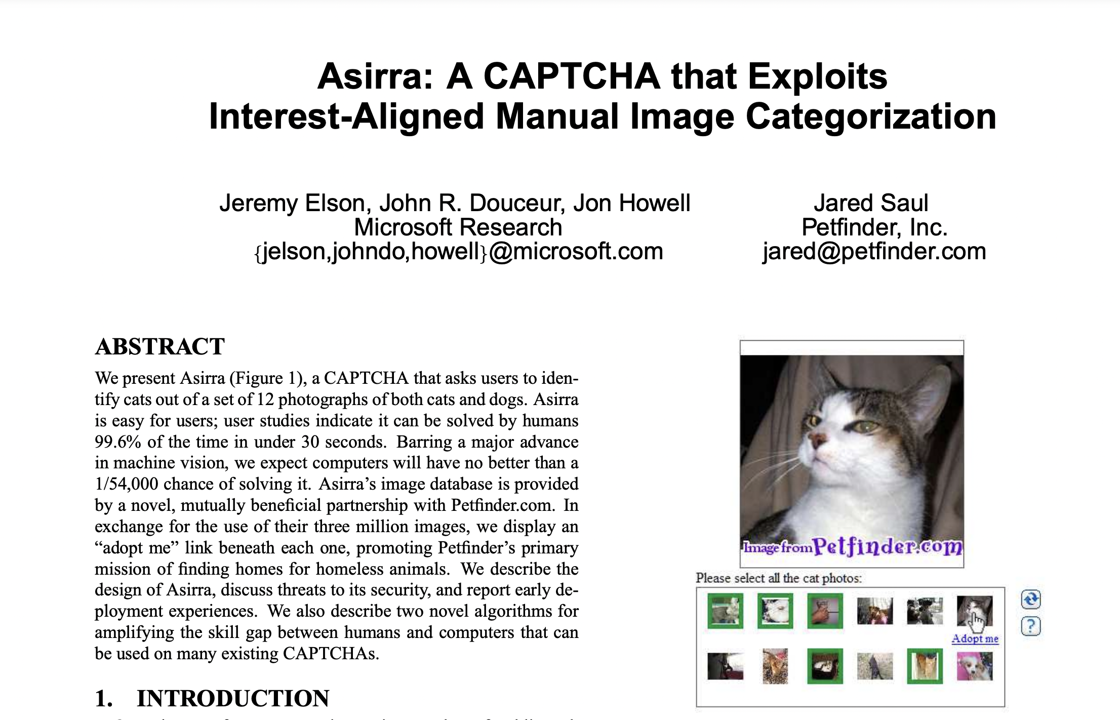
Adding Perspective to Vision Research: Vision is more than classifying pixels
https://www.microsoft.com/en-us/research/wp-content/uploads/2007/10/CCS2007.pdf

Slide 26
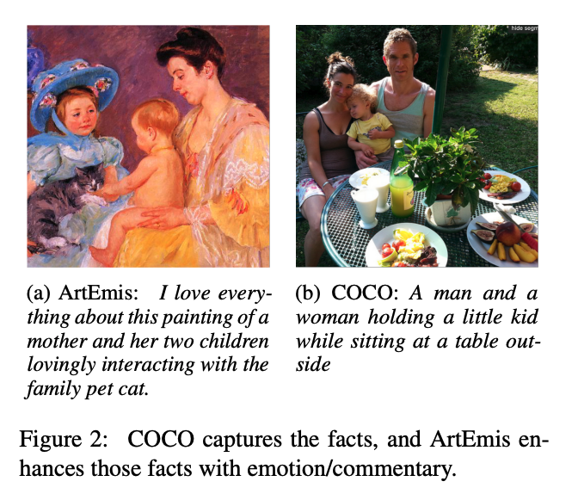
Adding Perspective to Vision Research COCO (Objective) → ArtEmis (Subjective)
Subjective Emotion
Objective
Facts
More room for Audience Background:
Culture/Language

Slide 27
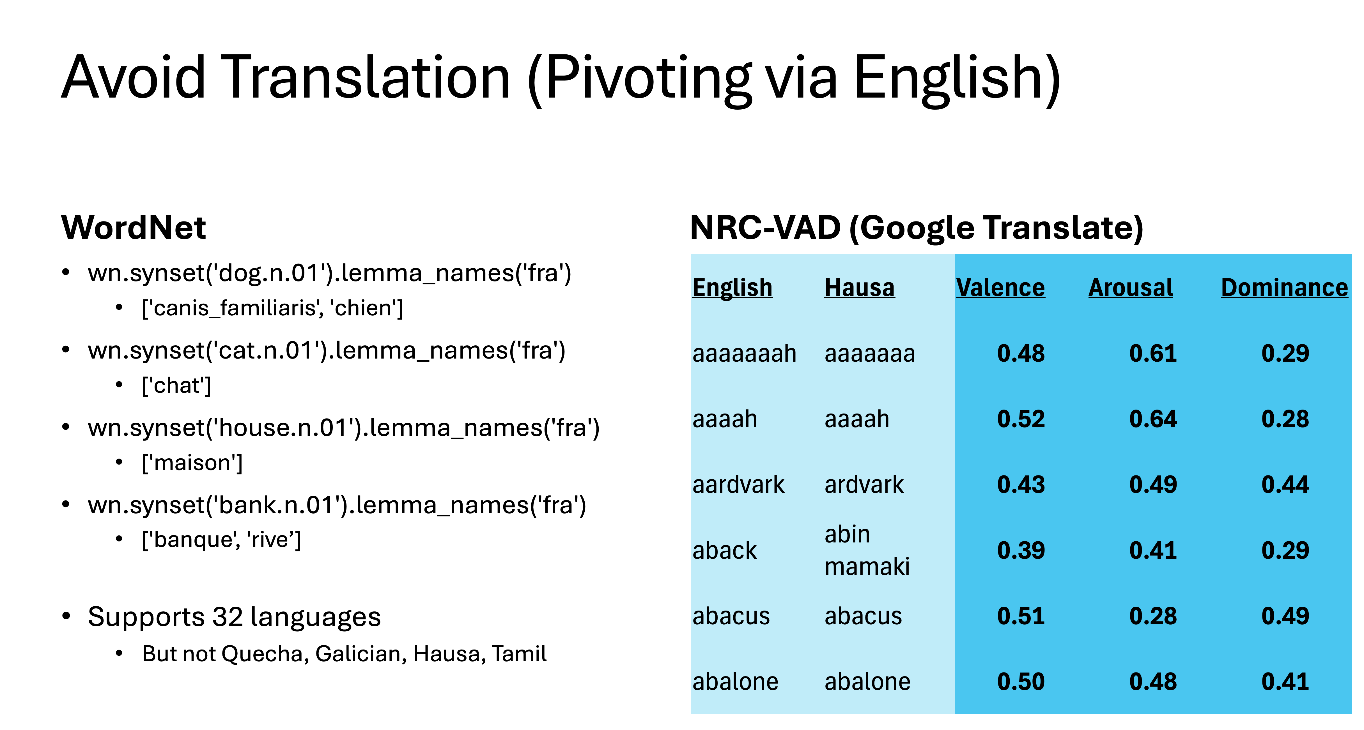
Adding More Perspectives to Vision (Do not pivot via English)
Input: Artworks
Annotations:
9 Emotion Labels
4 Positive:
Contentment, Awe, Excitement, Amusement
4 Negative:
Sadness, Anger, Fear, Disgust
1 Neutral
Captions in 28 languages
English glosses added to paper
to help readers (but not in corpus)

Slide 28
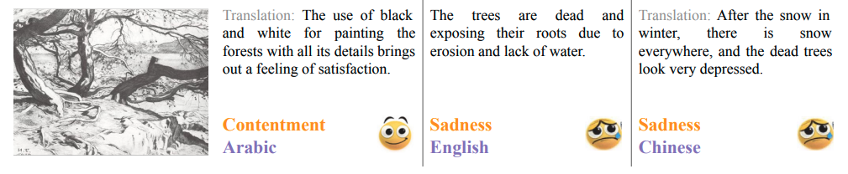
Why study more languages?
Vision:
Depends on both stimulus as well as context
Stimulus: Picture
Context: Language, Culture, Religion, Politics, Education, Background
Cliché:
Beauty is in the eye of the beholder

Slide 29
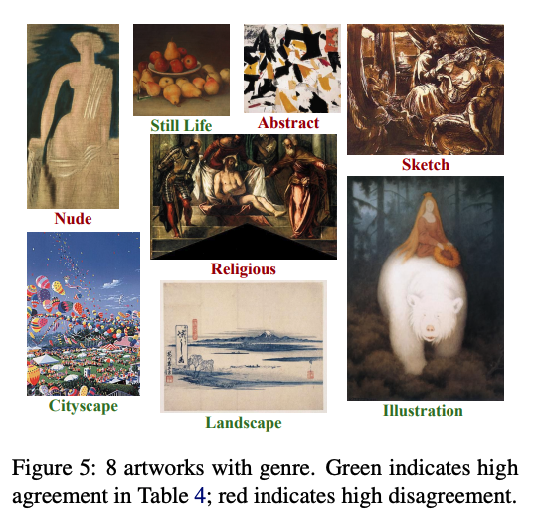
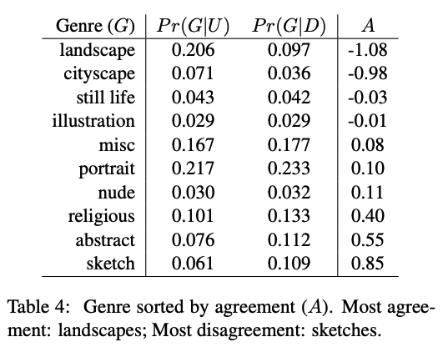
Emotion Labels: More Agreement in Some Genres; Less in Others

Slide 30
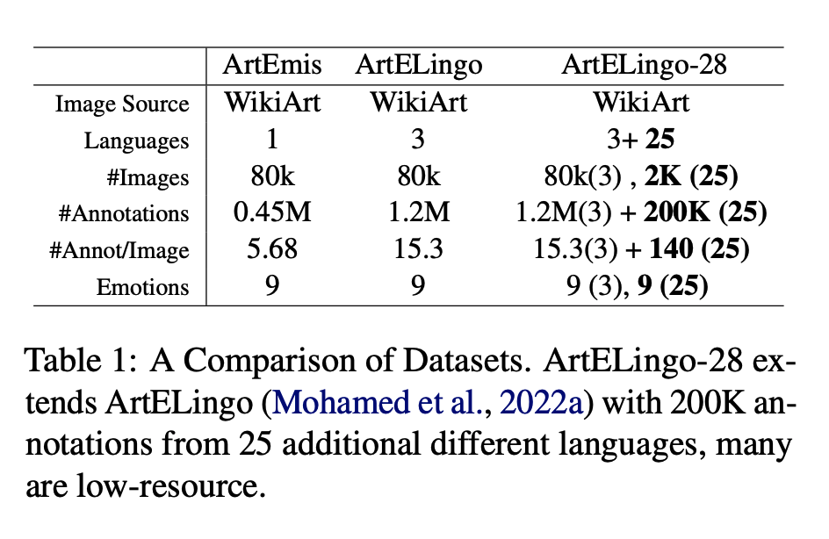
Quality Control
Benchmark | Languages | Annotators | Annotation Hours | Coordinators | Coordinator Hours
ArteLingo | 3 (en, zh, ar) | 7.8K turkers | 32K | 3 students | ??
ArteLingo-28 | 28 | 220 | 6.3K | 32 | 2.5K

Slide 31
Embrace Diversity & Multiple Perspectives
emotion labels:
disgust (Burmese)
awe (Malay)
captions focus
on chest
Burmese & Malay
on face and hair
Korean & Setswana
Hypothesis:
Predictable
Ethics Review

Slide 32
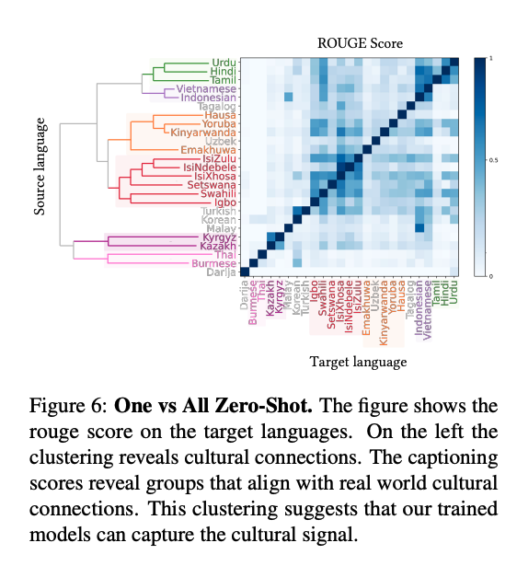
Vision: More than Pixels Communication (Shannon): Audience Matters
Art is a form of communication
between artist and audience
Background matters
Language
Culture
Task: Art, Lang → Caption
English pivot baseline:
Translate caption from English

Slide 33
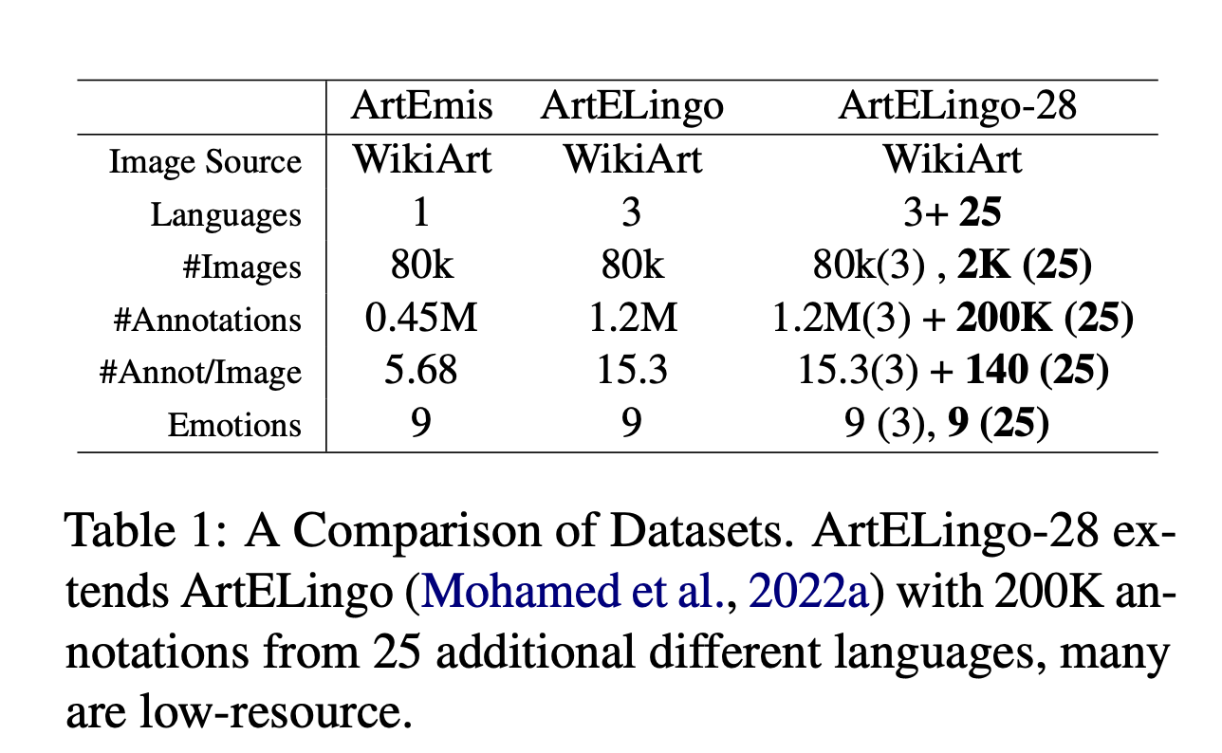

Slide 36
Boot-Strapping (Transfer Learning)
Boot-Strapping
Take advantage of high resource languages
To make progress on growth languages
Three Boot-Strapping Tasks: Learn Models in Growth Lang
Zero-Shot
No fine-tuning on data in target language
Few-Shot:
Fine-Tune with a little data in target language
One-vs-All Zero-Shot

Slide 37

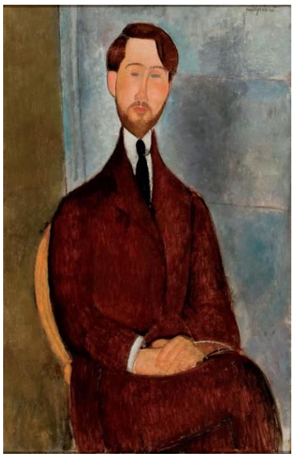
Future Research on Transfer Learning
Decrease similarity
Multi-modal LLM
E2E IMG CAPTIONNING
###Human: <img> </img> Could you describe the contents of this image for me? ###Assistant:
###Human: <img> </img> Could you describe the contents of this image for me? Use <lang1> and <lang2> words to describe the image ###Assistant:

Slide 38
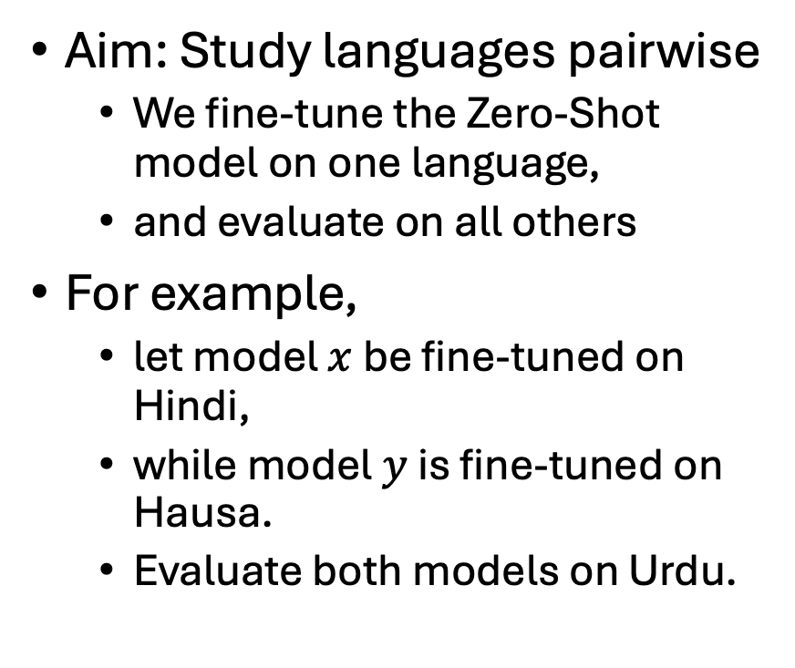
One-vs-All Zero-Shot
Aim: Study languages pairwise
We fine-tune the Zero-Shot model on one language,
and evaluate on all others
For example,
let model $x$ be fine-tuned on Hindi,
while model $y$ is fine-tuned on Hausa.
Evaluate both models on Urdu.
If both models perform similarly,
then there is no underlying cultural relationship between Hindi or Hausa with Urdu.
However, we learn that
Hindi is more like Urdu
than Hausa

Slide 39
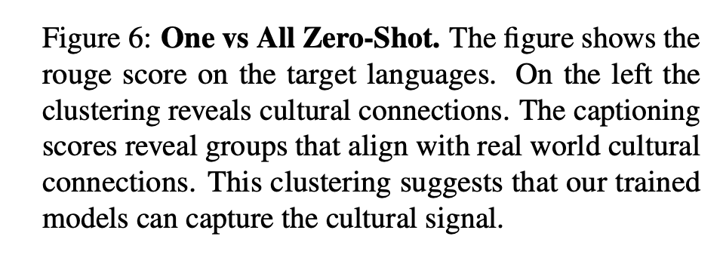

Slide 40
Embrace Diversity & Multiple Perspectives
emotion labels:
disgust (Burmese)
awe (Malay)
captions focus
on chest
Burmese & Malay
on face and hair
Korean & Setswana
Hypothesis:
Predictable

Slide 41
Deliverables
Survey current status
Identify available resources
Evaluate strengths and weaknesses
Engage Local Expertise
Bring together people
that would not normally work together
Establish that we can do
better than pivoting via English
Resources
Re-use (or create, if necessary)
to encourage more research
on growth languages
embracing diversity
and multiple perspectives
Develop a catalog/hub for
datasets, models and other resources
like HuggingFace
Inclusive playground for
Sharing: Encourage community to upload resources
Ease-of –Use
Easy to find popular stuff
Easy to try things out
(without downloading)
Gamify Annotation
Make annotation fun
Like the ESP Game

Slide 42
Project Overview
Low Resource Languages
Growth Languages
Quechua (Peru)
Galician (Spain)
Plan (6 weeks)
Collect resources (2 weeks)
Improve perf of MT & NLP (3w)
Distribute models/corpora (1w)
Hausa (Nigeria)
Tamil (India)
Plan (6 weeks)
Resources
Survey available resources
Assess Quality
Re-use and build (if necessary)
Hub / Gamify (ESP Game)
Beat Pivot-via-English Baseline

Slide 43
PMI → Word2vec → BERT → Chatbots → …
Historical Precedents
Word Associations: doctor primes nurse
Perplexity (Shannon), Cloze task, Fill mask
``You shall know a word by the company it keeps’’
Collocations in Lexicography
Future
Multiple Perspectives

Slide 44
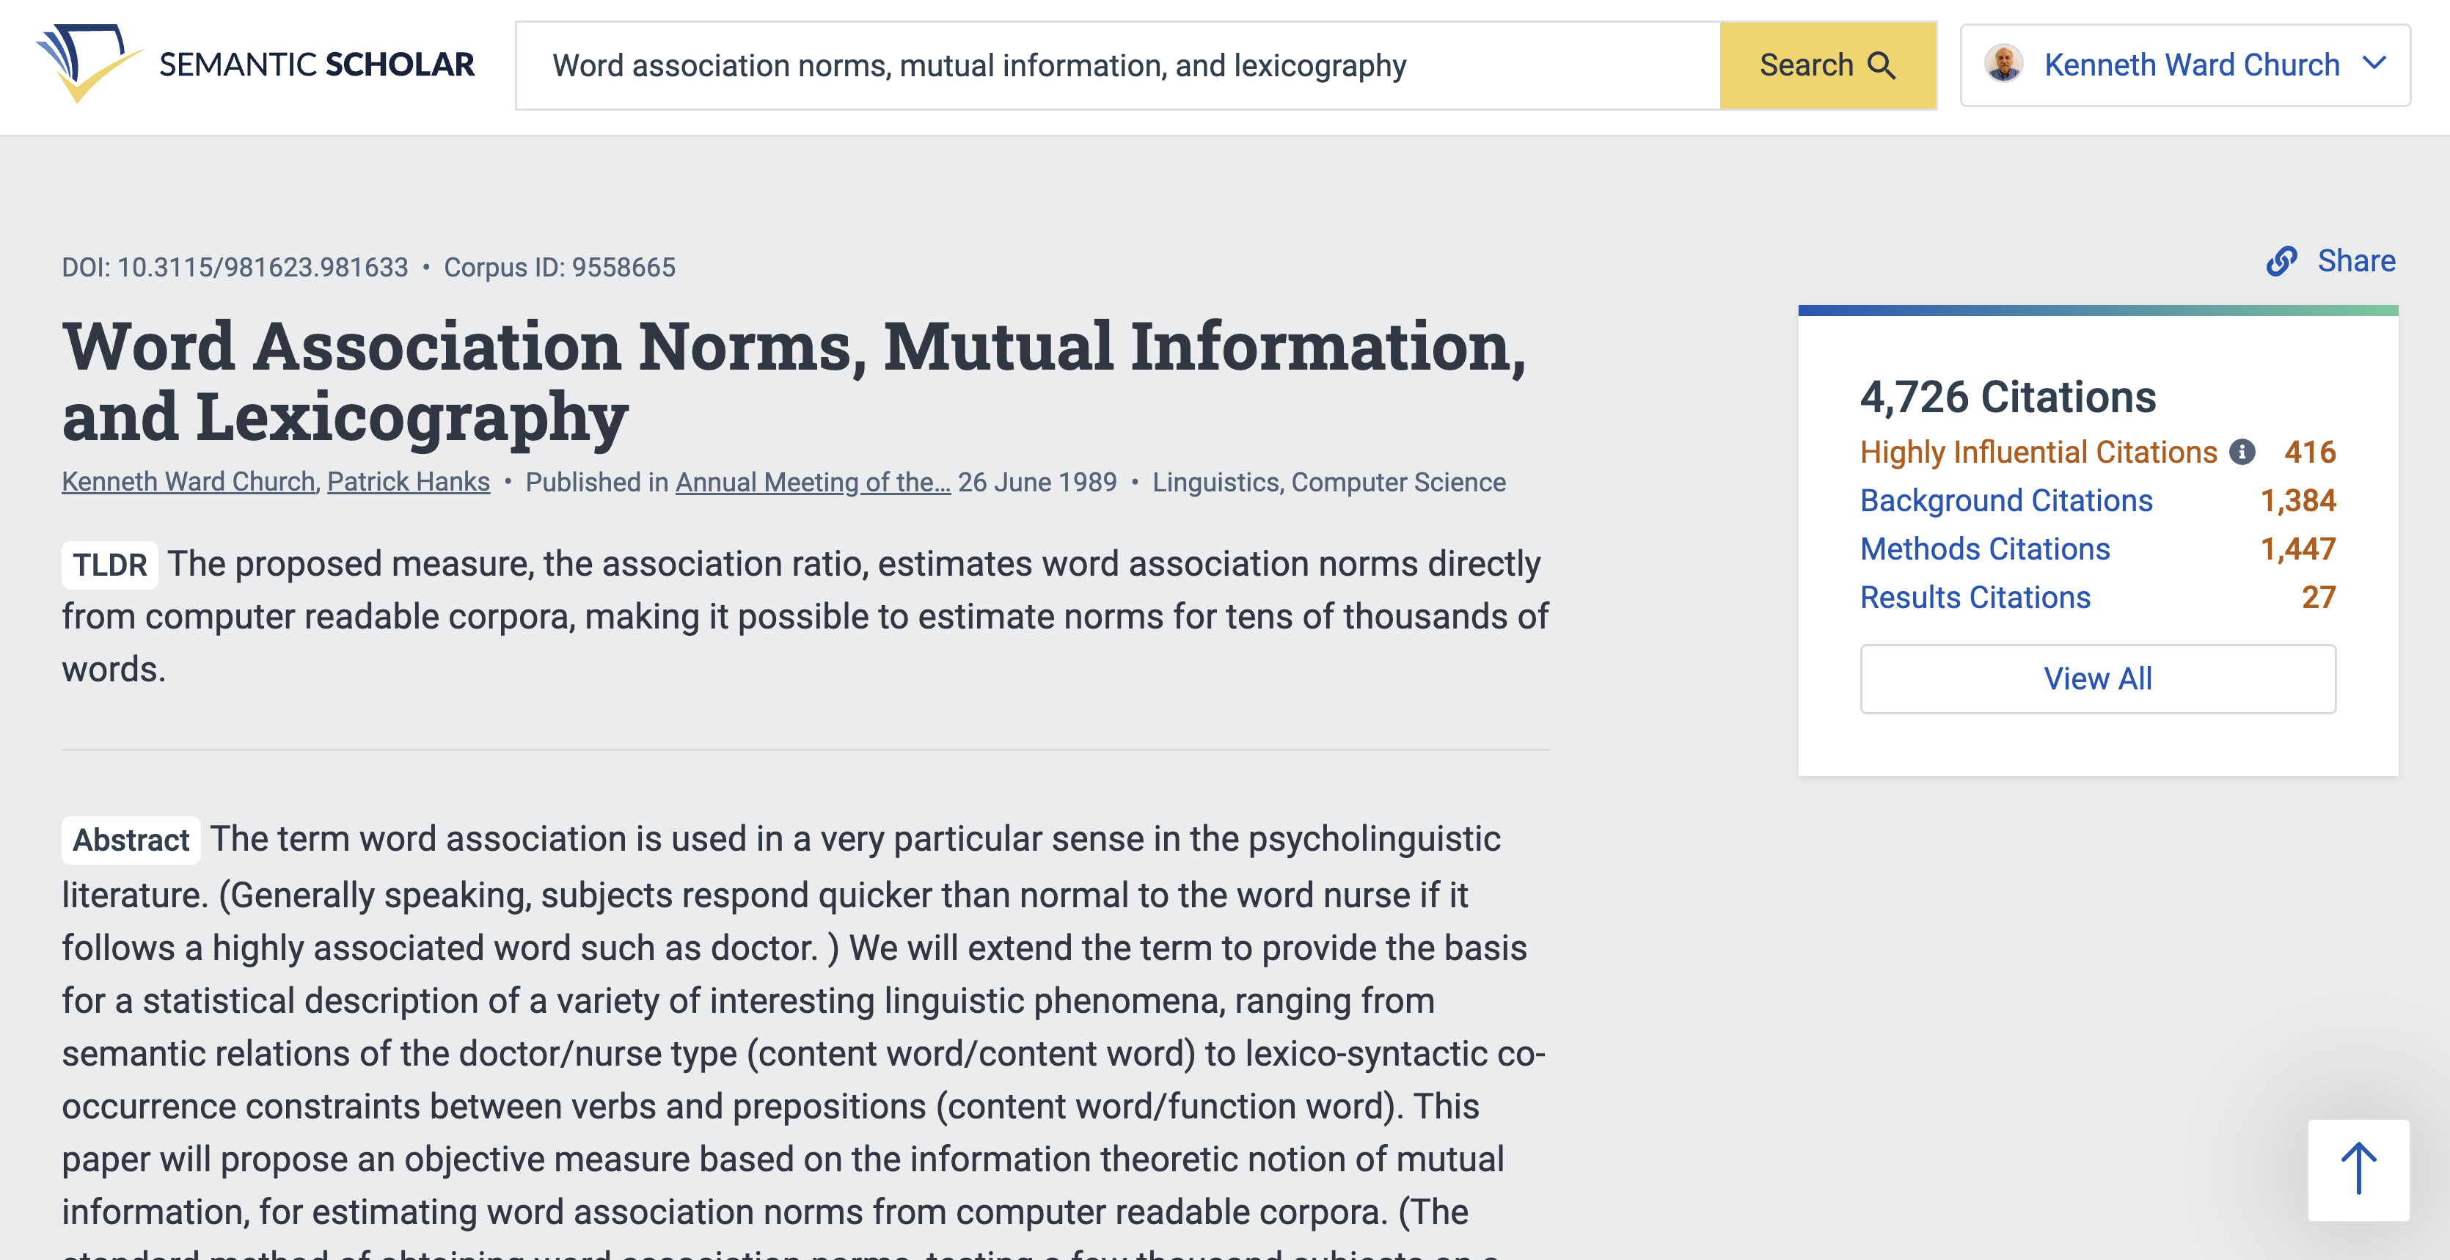

Slide 45
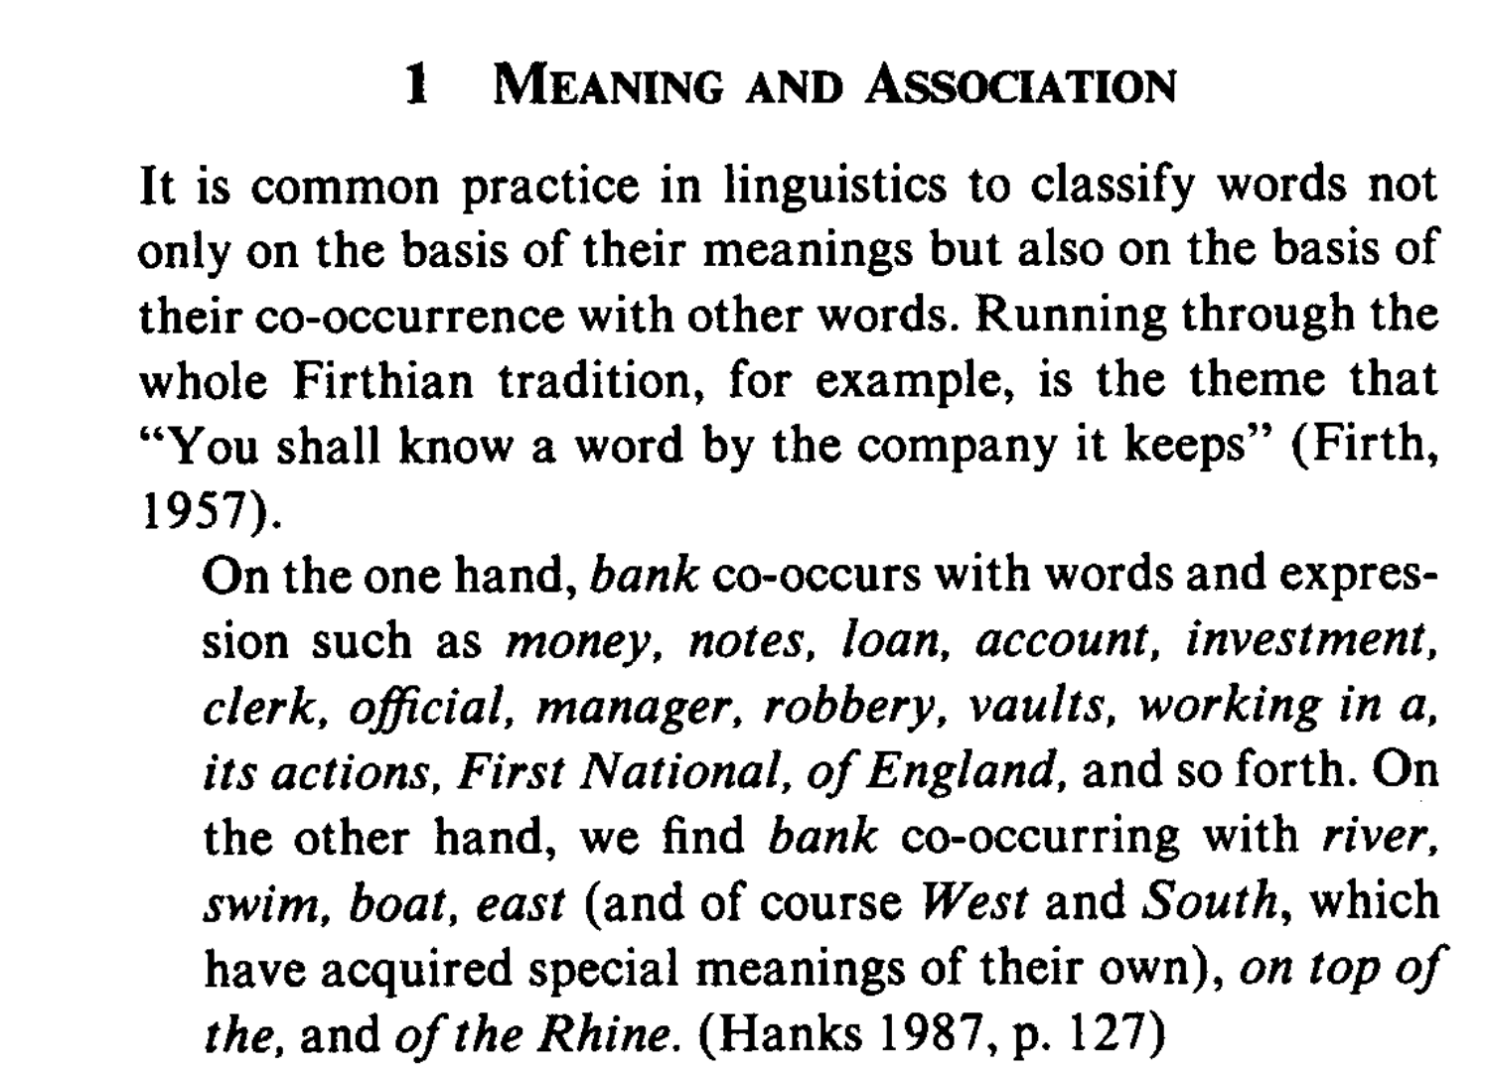
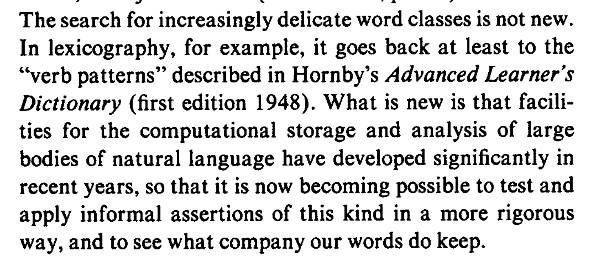
``You shall know a word by the company it keeps’’

Slide 46

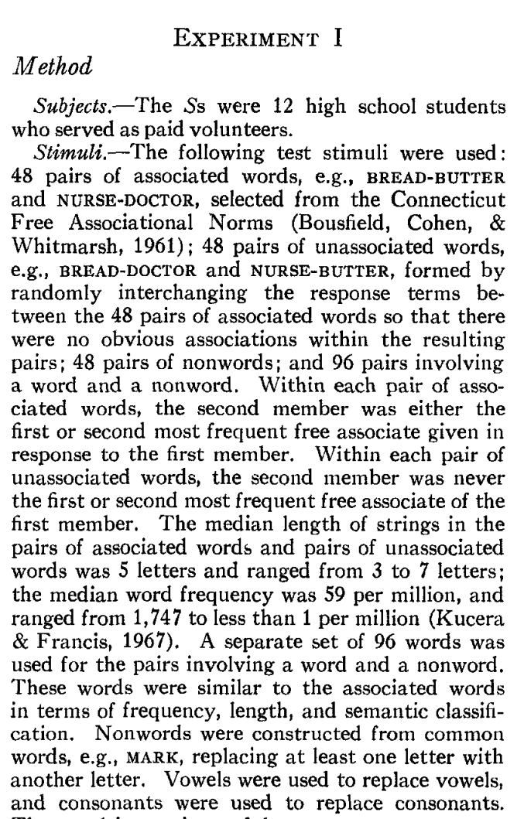
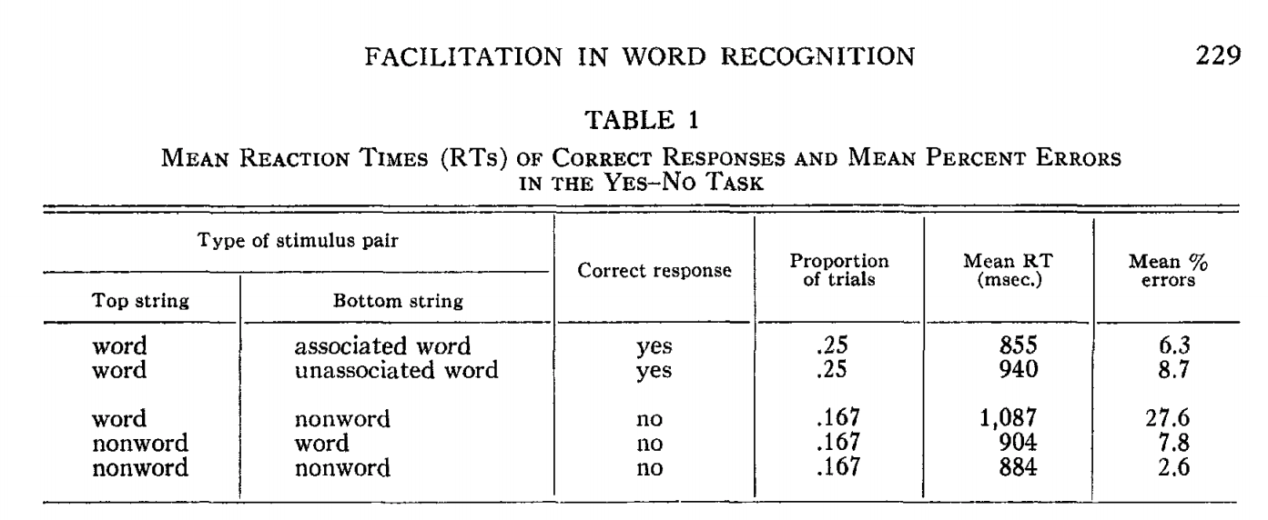
Priming & Word Associations Task: Subject is given two strings and responds “yes” if both are words

Slide 47
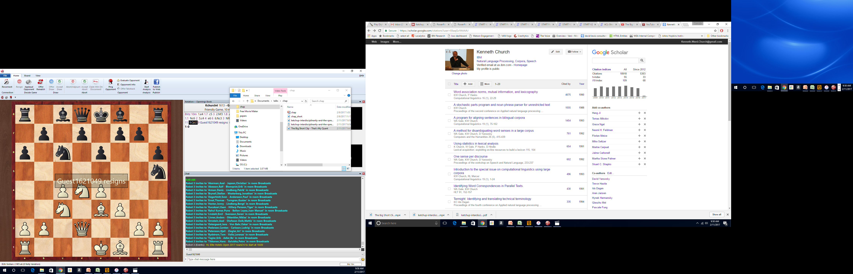

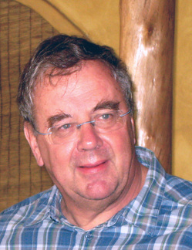

Slide 48
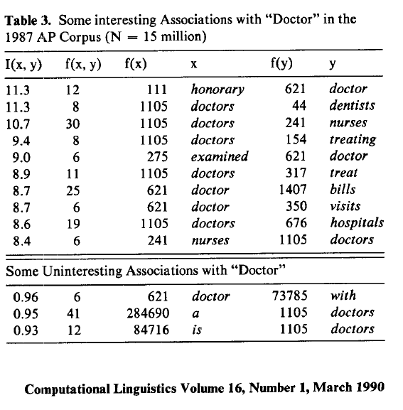
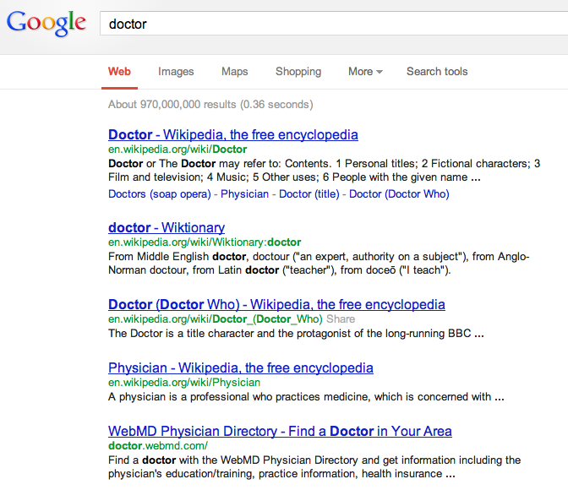
There is no data like more data
Counts are growing 1000x per decade
(same as disks)
Counts are growing 1000x per decade
(same as disks)
Rising Tide of Data Lifts All Boats

Slide 49
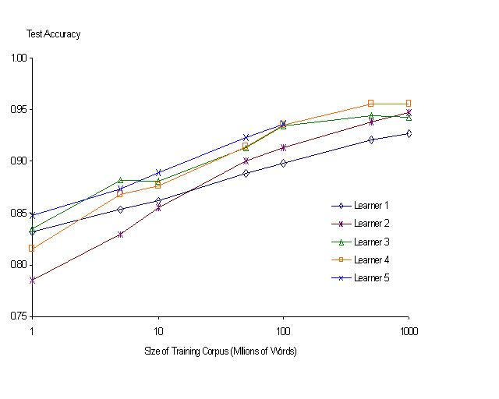
“It never pays to think until you’ve run out of data” – Eric Brill
Moore’s Law Constant:
Data Collection Rates → Improvement Rates
Banko & Brill: Mitigating the Paucity-of-Data Problem (HLT 2001)
No consistently
best learner
There is no data like more data
Quoted out of context
Fire everybody and
spend the money on data

Slide 50
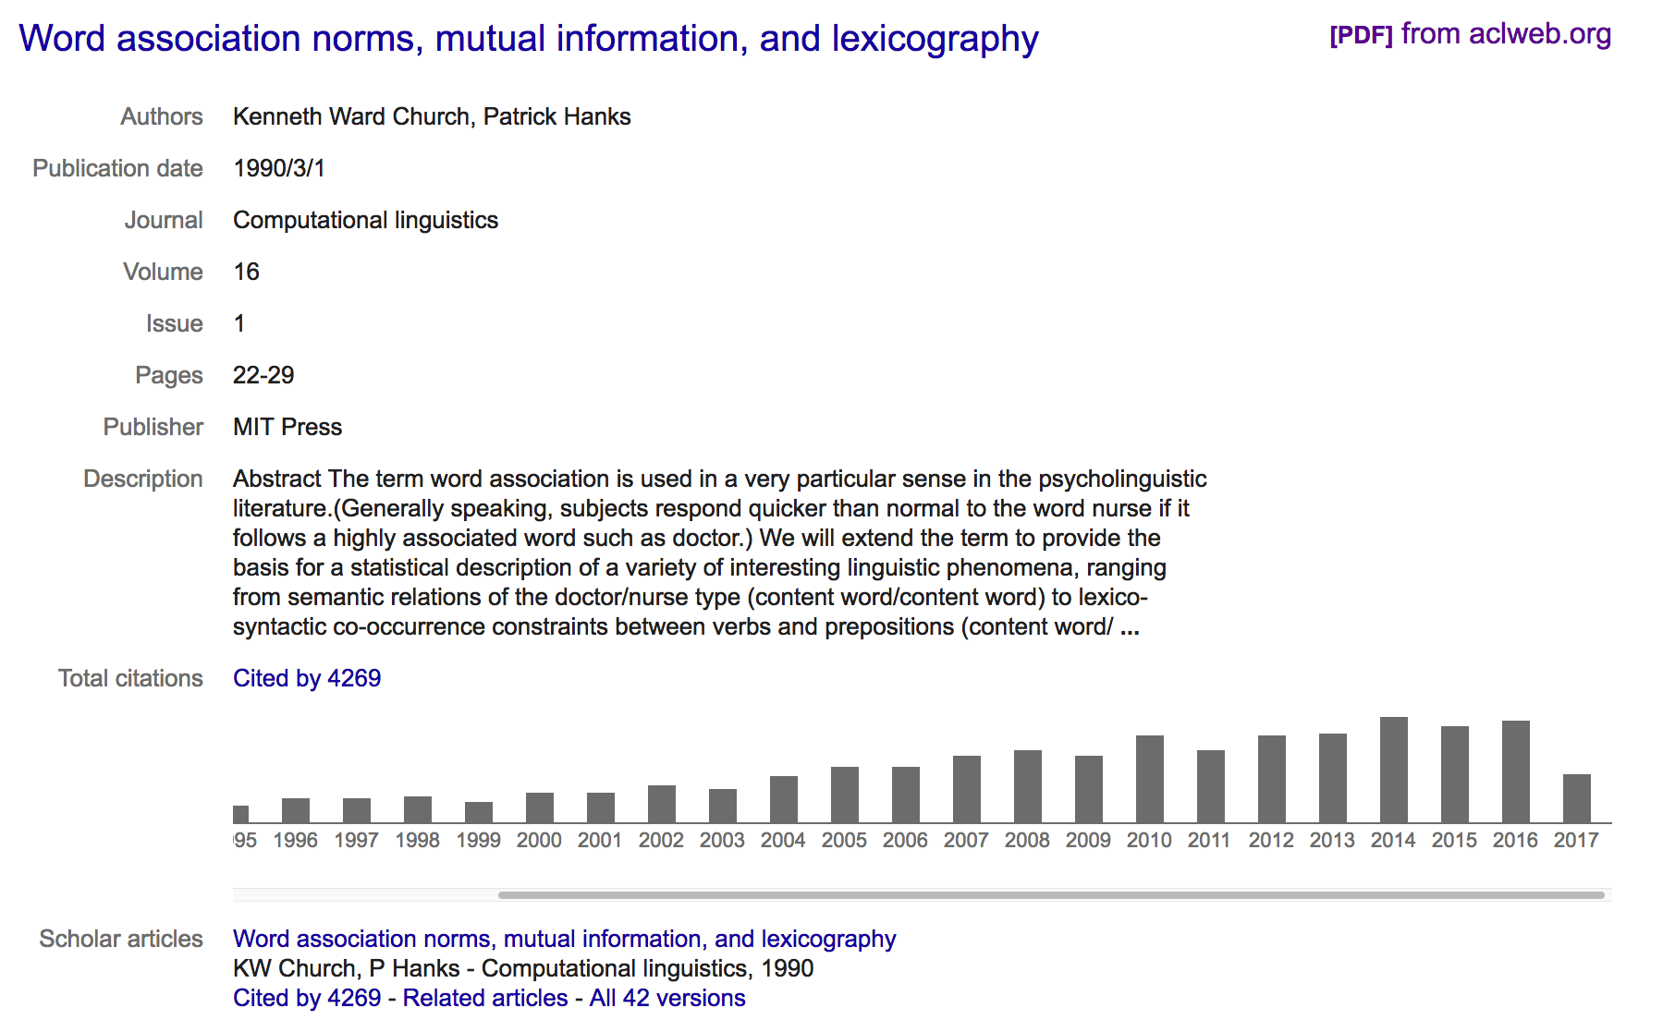
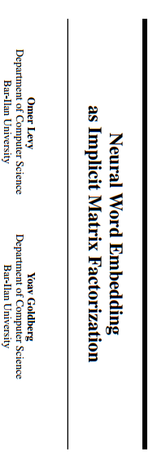
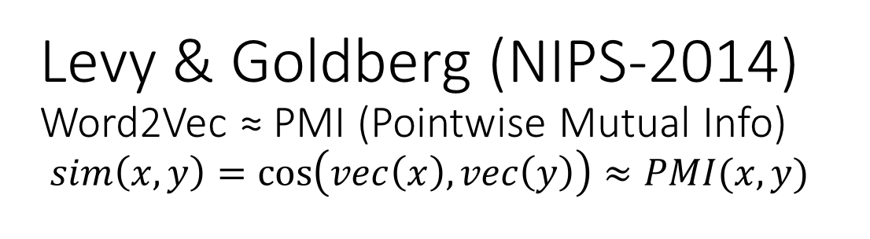
Levy & Goldberg (NIPS-2014) Word2Vec ≈ PMI (Pointwise Mutual Info) $sim\left(x,y\right)=\cos\left(vec\left(x\right), vec\left(y\right)\right)≈PMI(x,y)$
What happened in 2014?

Slide 51
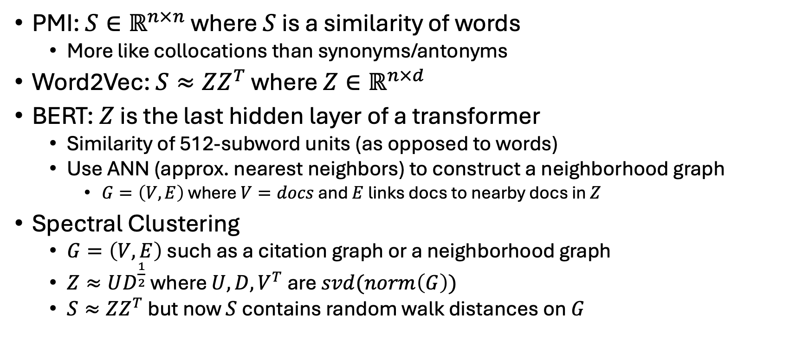
PMI → Word2Vec → BERT → Spectral Clustering
PMI: $S∈ℝ^{n×n}$ where $S$ is a similarity of words
More like collocations than synonyms/antonyms
Word2Vec: $S≈ZZ^{T}$ where $Z∈ℝ^{n×d}$
BERT: $Z$ is the last hidden layer of a transformer
Similarity of 512-subword units (as opposed to words)
Use ANN (approx. nearest neighbors) to construct a neighborhood graph
$G=\left(V,E\right)$ where $V=docs$ and $E$ links docs to nearby docs in $Z$
Spectral Clustering
$G=\left(V,E\right)$ such as a citation graph or a neighborhood graph
$Z≈UD^{\frac{1}{2}}$ where $U,D,V^{T}$ are $svd(norm\left(G\right))$
$S≈ZZ^{T}$ but now $S$ contains random walk distances on $G$

Slide 52
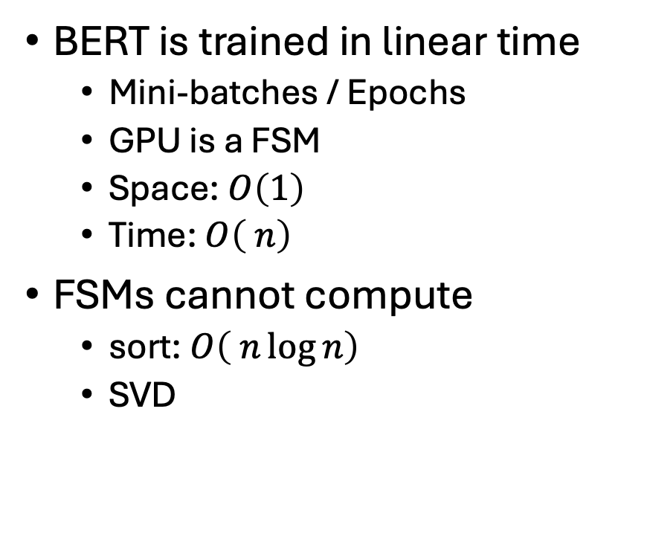
Advanced Topic: BERT is too fast
BERT is trained in linear time
Mini-batches / Epochs
GPU is a FSM
Space: $O\left(1\right)$
Time: $O\left( n\right)$
FSMs cannot compute
sort: $O\left( n\log{n}\right)$
SVD
Conjecture:
The embedding problem is bounded above and below by SVD
Consequence:
BERT is too fast → Losses

Slide 53
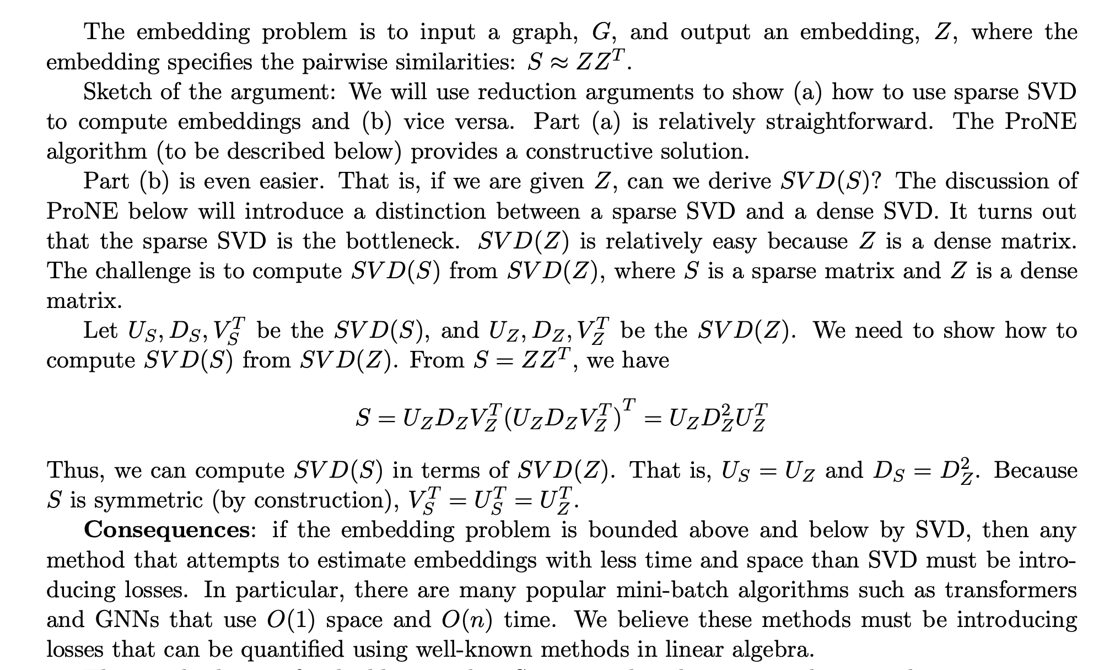

Slide 54
How to succeed? (get beyond publishing)
How to get citations
Paradigm Shift (Kuhn)
First? Last? Best?
Probably not
Better:
Accessible
Helpful to audience
Data
Tools
Survey
Accessible
Initial promising results
promising >> convincing
Leave enough undone for students to contribute
and benefit by doing so

Slide 55
Word2vec is popular (massively cited)
Word2vec is not first, last or best to discuss
Vector spaces, embeddings, analogies, similarity metrics, etc.
But word2vec is simple and accessible
Anyone can download the code and use it in their next paper.
Any many do (for better and for worse)
Available downloads
Pre-computed vectors (no training required)
Code for training your own vectors on your own corpora

Slide 56
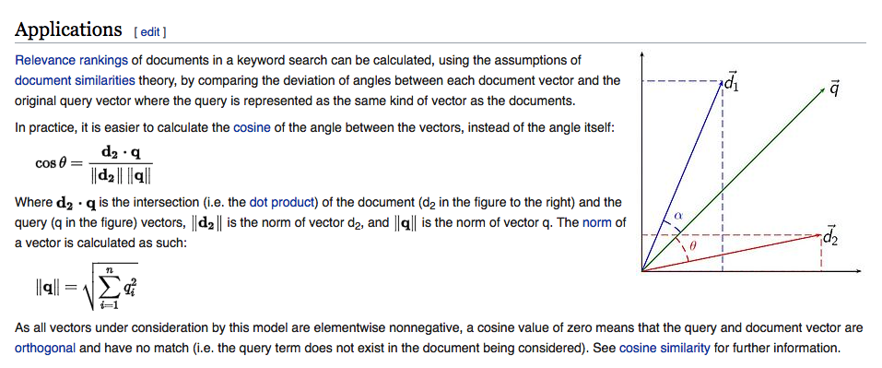
Embeddings: Similarity of docs/words ≈ cos (dot product)

Slide 57
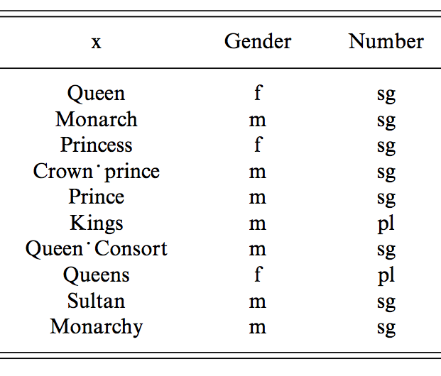
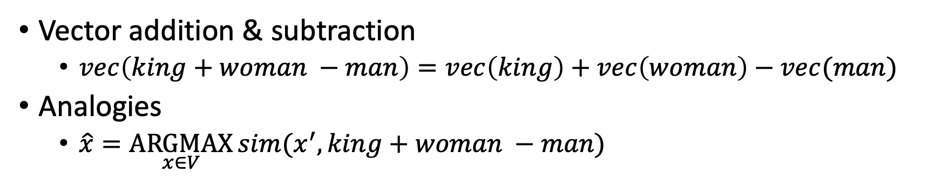
man : woman :: king : x
Vector addition & subtraction
$vec\left(king+woman −man\right)=vec\left(king\right)+vec\left(woman\right)−vec(man)$
Analogies
$\hat{x}=\underset{x∈V}{ARGMAX}{sim(x^{′}, king+woman −man)}$

Slide 58
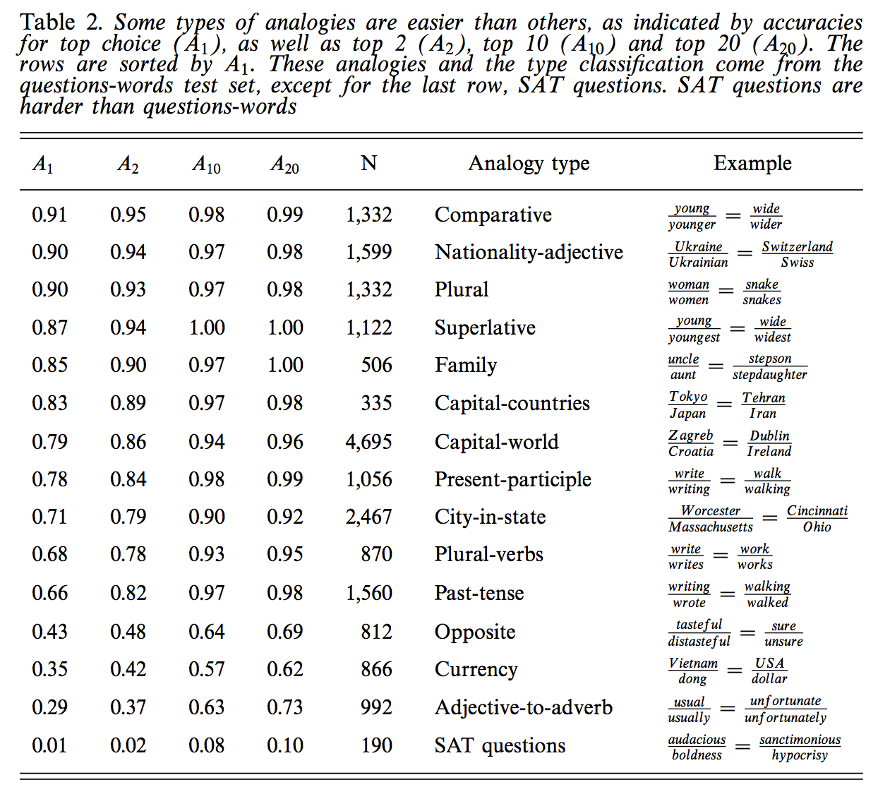
Some analogies are easier than others
Tweets
RT @tallinzen: sure, king:queen etc, but did you know word2vec gets real SAT analogies right just 1% of the time?
15 copies of this tweet
Some by NLP experts
Resources Debate
WordNet &
British National Corpora

Slide 59
Need to Re-organize Courses (Interdisciplinary Re-Org)
Current Courses (and Conferences)
Future
Machine Learning (ML)
Vision
Natural Language (NLP)
Machine Translation (MT)
Information Retrieval (IR)
Speech
Machine Learning (ML)
ML Applications
Vision/NLP/MT/IR/Speech

Slide 60
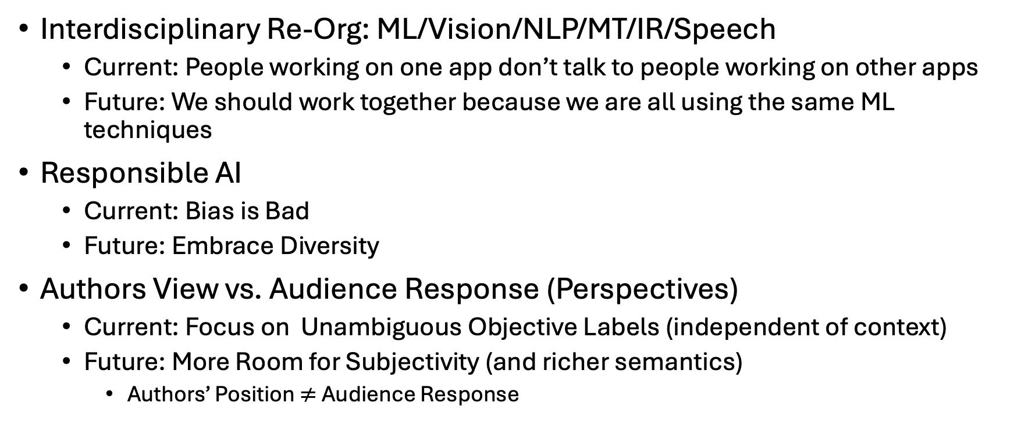
Soap Box: My Views
Interdisciplinary Re-Org: ML/Vision/NLP/MT/IR/Speech
Current: People working on one app don’t talk to people working on other apps
Future: We should work together because we are all using the same ML techniques
Responsible AI
Current: Bias is Bad
Future: Embrace Diversity
Authors View vs. Audience Response (Perspectives)
Current: Focus on Unambiguous Objective Labels (independent of context)
Future: More Room for Subjectivity (and richer semantics)
Authors’ Position $≠$ Audience Response

Slide 61
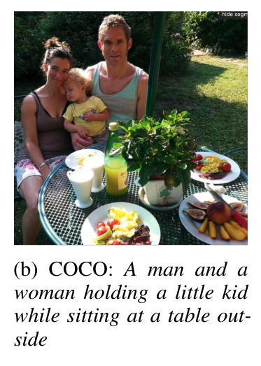
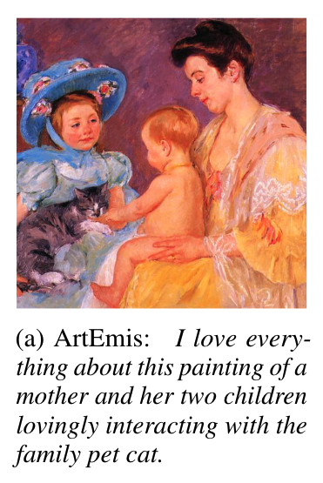
Vision: Facts → Opinions
Facts
Opinions

Slide 62
Adding Perspective to Speech/Vision Research COCO (Objective) → ArtEmis (Subjective)
Subjective Emotion
Objective
Facts
More room for Audience Background:
Culture/Language
Nouns: man, woman, kid, table
Modifiers: love, interacting, family

Slide 63
Adding Perspective to Vision Research: Vision is more than classifying pixels
https://www.microsoft.com/en-us/research/wp-content/uploads/2007/10/CCS2007.pdf

Slide 64


No Language Left Behind (NLLB)

Slide 65


Ambiguity: No Single Correct Gold Label
A difference of opinion $≠$ Error
Common Challenge in Language Apps
Machine Translation
Web Search
Even Part of Speech Tagging!
Standard Solution
Score over multiple references (many gold standards)
Machine Translation: BLEU, ROUGE, METEOR, CIDr
Web Search: NDCG
Candidate labels: baseball cap, cap, green hat, hat, head.
Can you guess which one is in the gold standard?

Slide 66
Pragmatics
Candidate labels: baseball cap, cap, green hat, hat, head.
Can you guess which one is in the gold standard?
Head is weird
Because it serves no useful purpose to mention that.
(You might mention that if one of the girls were headless)
Purposes of modification
Descriptive
Discrimination
Green vs. White
Hat vs. No Hat
Offense vs. Defense
One Bounding Box vs. Two?
One: describe what is inside the box
Two: compare and contrast

Slide 67
Focus: Foreground vs. Background
Focus (leading role): Frisby, Throw, Offense
Supporting role: Defense
Background: Spectators
Photographer tells us
what’s central
and what isn’t

Slide 68
Classic Challenges in Philosophy of Language Compare & Contrast Language in Visual Genome (VG) with NLP Corpora
Bounding Box Semantics: Too Limiting
<NP> <relation> <NP>
NPs in VG are usually rigid designators that mean the same thing in all contexts
Few abstract nouns (ideas), predicates (verbs, adj), variables (pronouns)
Most VG nouns are visual (and less about other senses)
More entropy in nouns than relations
8 boring relations cover bulk of the cases
Linguists are more interested in predicates than arguments
Modifiers are limited to a single box
Relative Relations: girl with green hat vs girl on defense
Aggregations over boxes
Count vs. Mass: Cloudy Sky, Sandy Beach
Definite vs. Indefinite: girls playing frisbee (as opposed to many other people in picture)
A horse with two legs?

Slide 69
Verbs, Subjunctive, Focus, Perspective, etc…
Pictures vs. Videos
Captions on pictures have more nouns:
girl with green hat
Captions on videos have more verbs:
girl throwing frisbee
Possible Worlds: Subjunctive, Hedges
The girl on defense might block the throw,
but probably won’t
Focus: girl on offense vs. girl on defense
Perspective: photographer vs. audience

Slide 70
More Predicates/Perspectives (Predicates = Verbs/Adjectives)

Slide 71


Slide 72
Few Shot & Zero Shot

Slide 73
Anglo-Centered Baseline
Use English as Pivot Language
Anglo-Centered Vision Task:
Input: Picture
Output: English Caption
If you want a caption in another language:
Just translate English caption to that language
Challenge:
Can we do better than that?

Slide 74


Agreement (A) on Emotion Labels: More A: Landscapes → Less A: Sketches

Slide 75
Agreement on Emotion Labels
By Genre
By Language (or perhaps Education?)

Slide 76
Agenda
PMI
Word2Vec: Factored PMI
BERT
Multi-lingual & Multi-modal BERT
One Model to RULE THEM ALL???
VAD: Latent Dimensions → Interpretable Dimensions

Slide 77

Is Peer-Reviewing Worth the Effort?

Slide 78


Slide 79


Correlations over Time

Slide 80


Time >> Venue
Large Correlation with Time
Small Correlations with Venue

Slide 81


Slide 83


